Slide 1
Predictive Analytics System for Website Development Opportunities
~ Prepared By: George Jibin Verghese

Slide 2
Problem Statement & Objectives
Problem Statement
Many successful local businesses have strong customer ratings and engagement but lack an official website, limiting their digital presence and growth opportunities.
Objectives
Collect real-world business data using Google Places API.
Clean and prepare the dataset for analysis.
Explore business patterns through visualization.
Develop a machine learning model to predict website ownership.
Identify and rank high-potential businesses for website development.

Slide 3
Why Predictive Analytics?
Why is this important?
Traditional lead identification relies on manual searching, which is time-consuming and inefficient.
Predictive Analytics enables organizations to:
Identify businesses with high growth potential.
Prioritize leads using data-driven insights.
Reduce manual effort in lead generation.
Improve decision-making through machine learning.

Slide 4
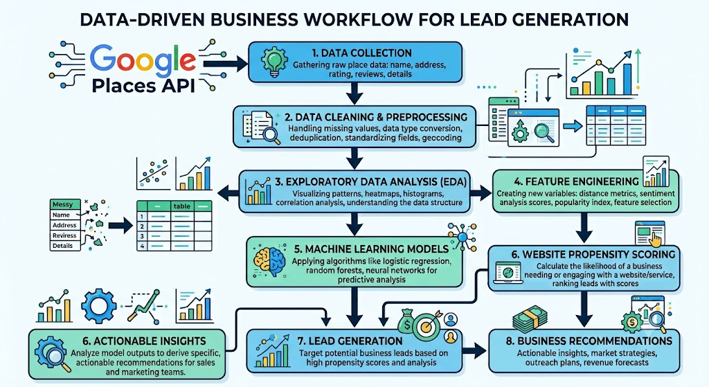
Data Workflow
The workflow transforms raw business data into actionable website development opportunities using predictive analytics.

Slide 5
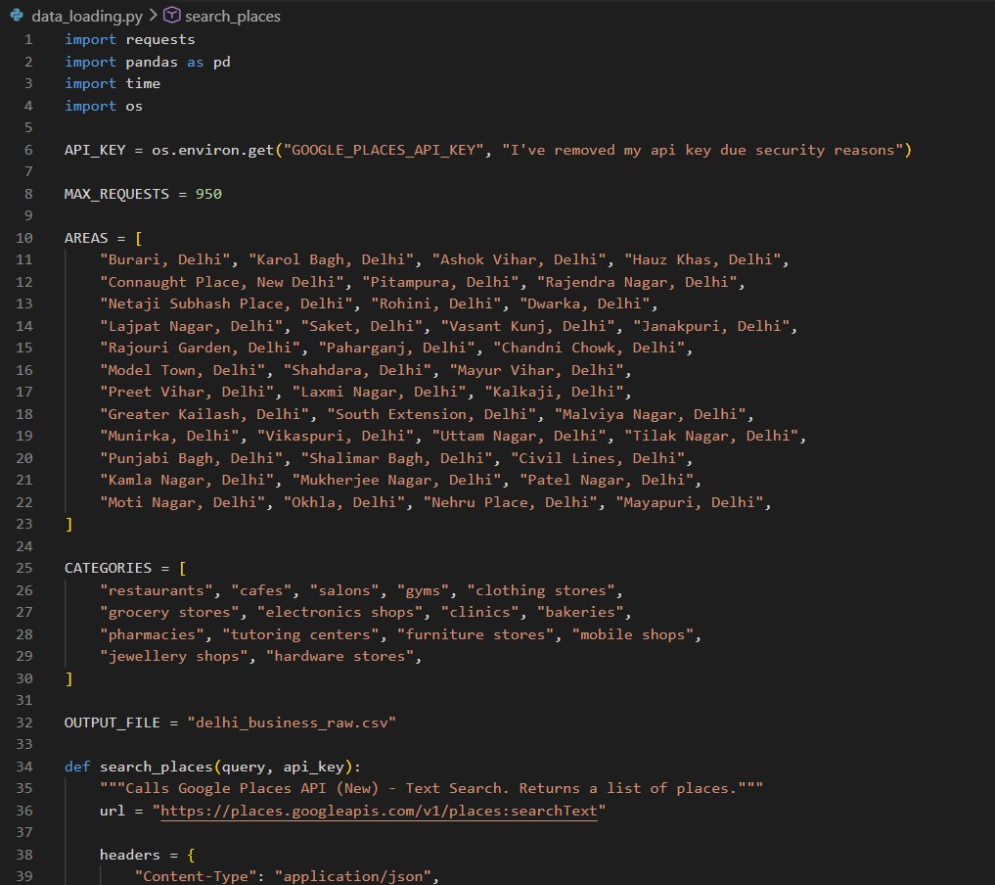
Data Collection
Data Source: Google Places API
Dataset Overview
10,000+ business records
35 Delhi localities
15 business categories
Automated API-based data collection
Attributes Collected
Business Name
Area
Category
Rating
Key Point
Using live API data provides a realistic and up-to-date dataset for predictive analysis.
Business Status
Review Count
Website
Phone Number
Price Level

Slide 6
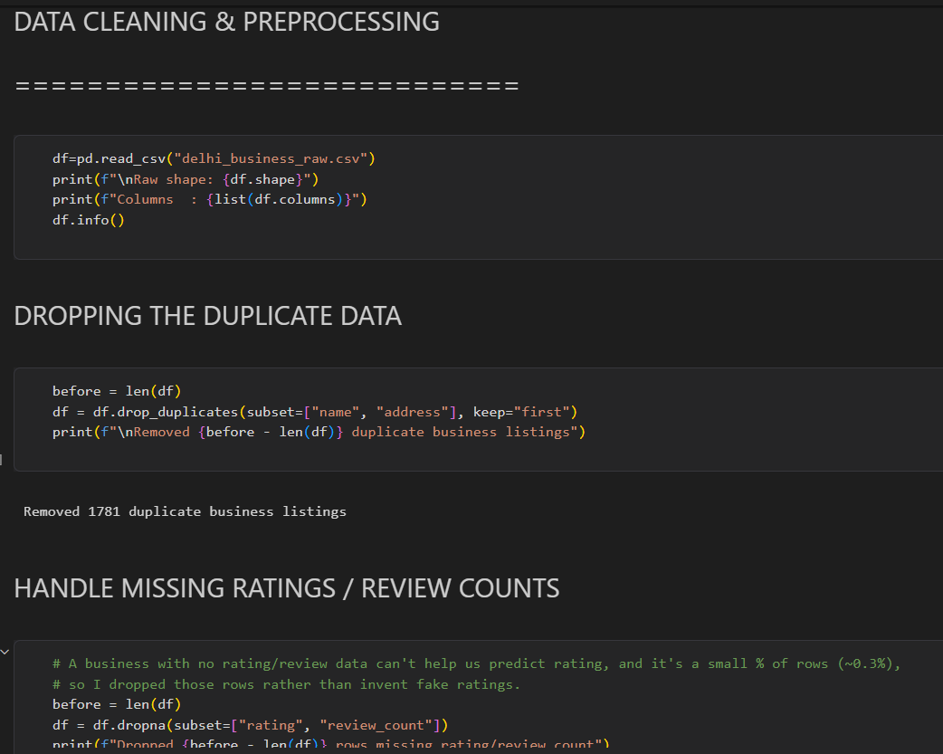
Data Preprocessing & Feature Engineering
Data Cleaning
Removed duplicate records
Handled missing values
Standardized text values
Processed business status
Verified dataset quality
Engineered Features
Has Website
Has Phone
Review Outlier
Number of Business Types
Cleaned Price Level
Outcome
A clean and machine-learning-ready dataset suitable for predictive modelling.

Slide 7
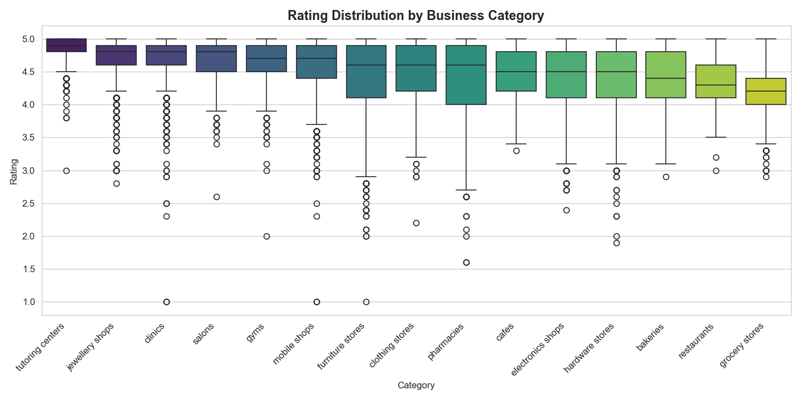
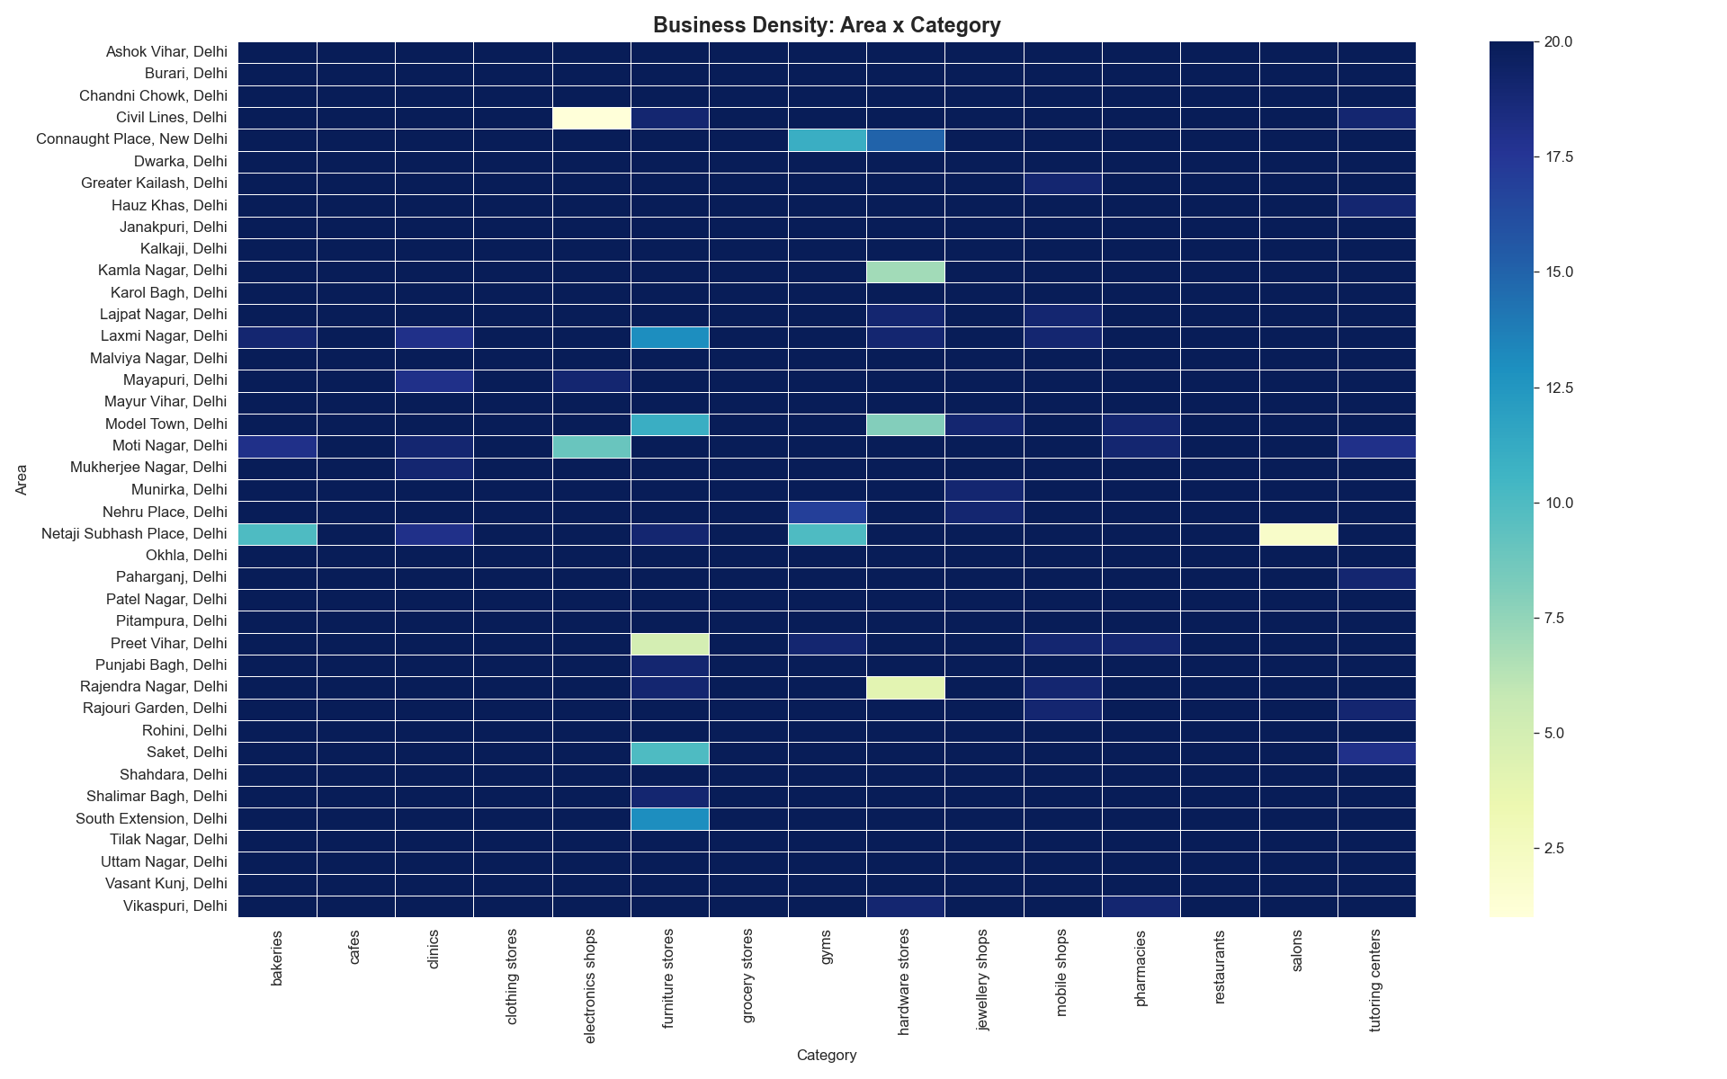
EDA & Visualization
Key Insights
Most businesses maintain ratings above 4.0.
Businesses with websites generally receive higher customer engagement.
Some business categories have significantly lower website adoption.
Review count shows a positive relationship with business popularity.
Purpose
EDA helped uncover patterns and guided feature selection for model development.

Slide 8

Machine Learning Models

Slide 9
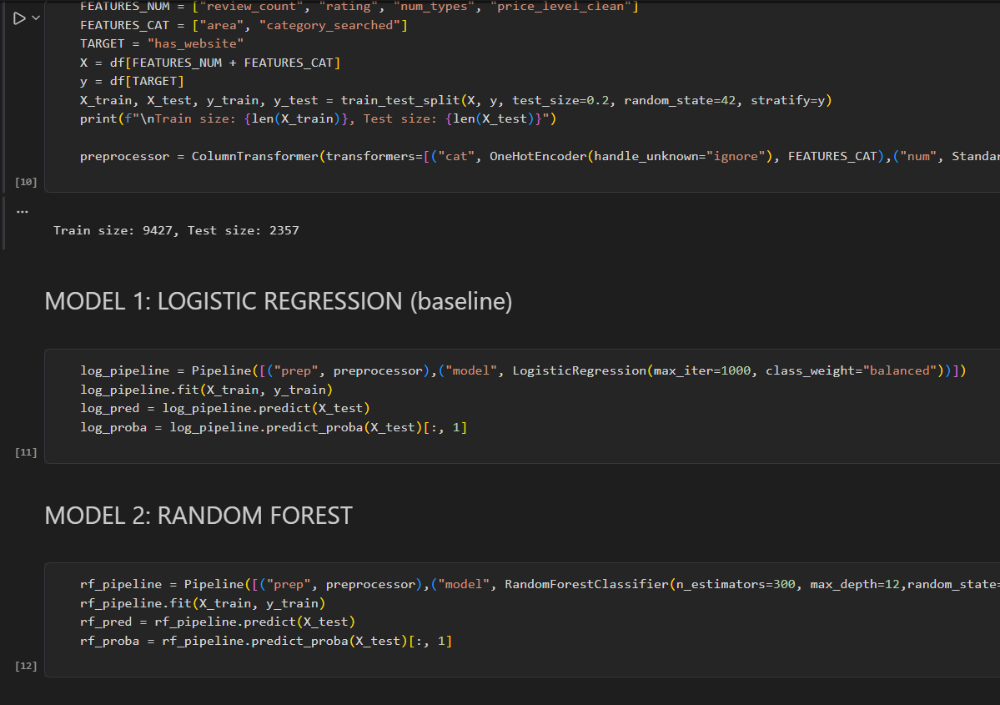
Machine Learning Models Used:
Logistic Regression
A supervised classification algorithm.
Predicts the probability of a business having an official website.
Serves as the baseline model for comparison.
Easy to interpret and computationally efficient.
Random Forest
An ensemble learning algorithm.
Builds multiple decision trees using different subsets of the data.
Combines predictions from all trees through majority voting.
Reduces overfitting and improves prediction accuracy.
Why Two Models?
Using multiple models allows performance comparison and helps select the most suitable algorithm for the business problem.

Slide 10
Machine Learning Models
Prediction Objective
Predict whether a business is likely to have an official website based on its characteristics.
Logistic Regression (Baseline)
Simple binary classification model.
Predicts the probability of a business having a website.
Used as a benchmark for comparison.
Random Forest (Final Model)
Ensemble model consisting of 300 decision trees.
Each tree makes a prediction using different subsets of the data.
Final prediction is based on the majority vote of all trees.
Captures complex relationships between business features.
Why Random Forest?
Higher predictive accuracy.
Handles complex feature interactions.
More robust and less prone to overfitting than a single decision tree.

Slide 11
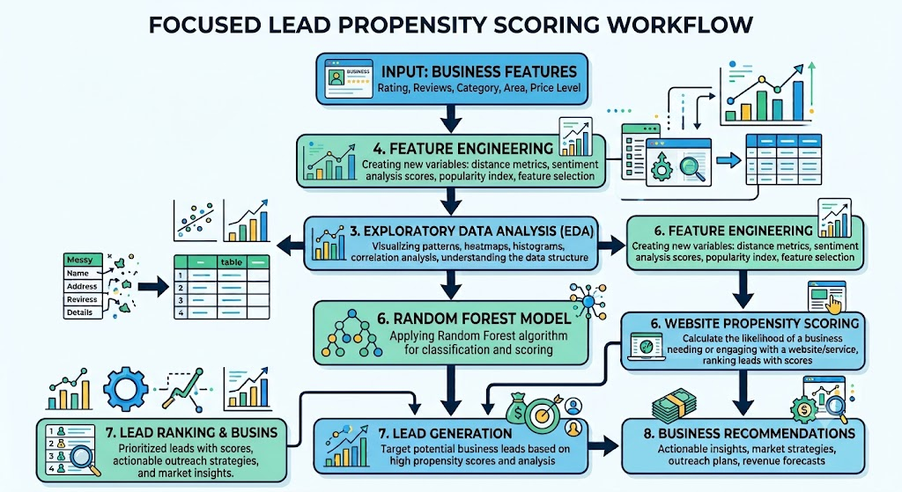
How the Prediction Works ?
Key Idea
The model learns patterns from businesses that already have websites and assigns a Website Propensity Score to every business. Businesses with a high score but no website are identified as high-priority website development leads.

Slide 12
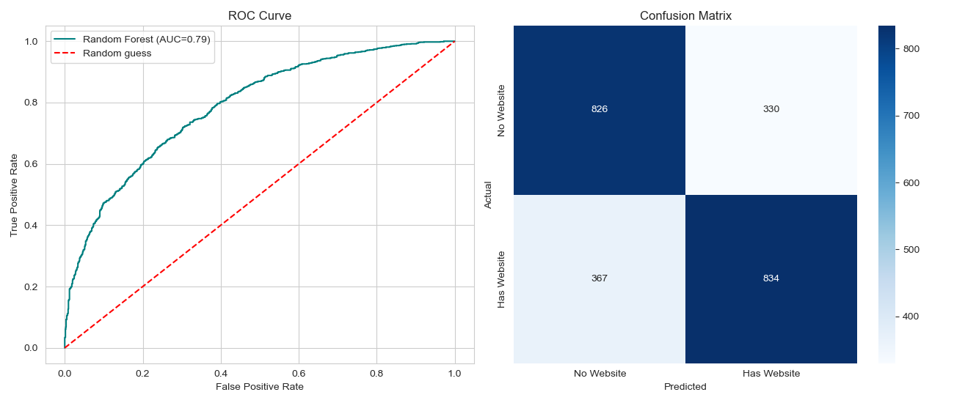
Model Performance
Model Results
Accuracy
70% of businesses were classified correctly.
ROC-AUC
0.77, indicating good ability to rank businesses by website propensity.
Confusion Matrix
Shows correct and incorrect classifications.
Helps evaluate where the model performs well and where misclassifications occur.
Why ROC-AUC Matters
Since the goal is to rank businesses rather than simply classify them, ROC-AUC is a more meaningful performance metric than accuracy.

Slide 13
Website Propensity Scoring & Lead Generation

Slide 14
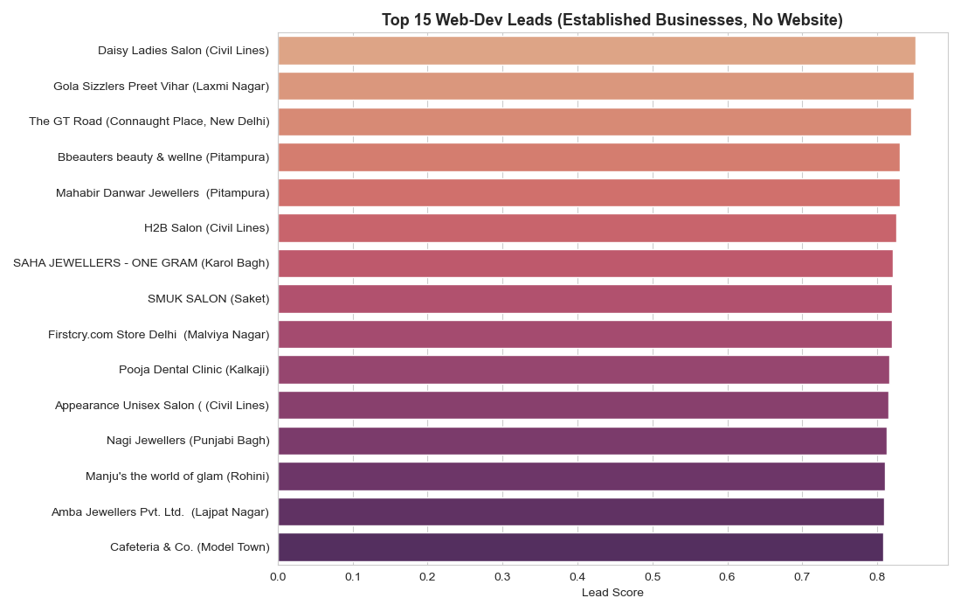
Website Propensity Scoring & Lead Generation
Website Propensity Score
The trained Random Forest model assigns each business a Website Propensity Score, representing how closely it resembles businesses that already have an official website.
High-Priority Leads
Businesses with:
High Ratings
High Review Counts
Strong Business Presence
No Official Website
These businesses were identified as ideal prospects
for website development services.

Slide 15
Business Insights & Recommendations
Key Insights
More than half of the analyzed businesses do not have an official website.
Review count is the strongest predictor of website ownership.
Hardware stores, pharmacies, and mobile shops present significant digital opportunities.
Predictive analytics enables efficient prioritization of website development leads.
Recommendations
Target businesses with high website propensity scores.
Offer customized website development packages.
Focus digital marketing efforts on high opportunity business categories.
Continuously retrain the model using updated API data.

Slide 16
Conclusion & Future Scope
Conclusion:
This project successfully developed an end-to-end predictive analytics system for identifying businesses with high website development potential.
By combining Google Places API, data preprocessing, exploratory analysis, and machine learning, the system generated actionable business insights and prioritized high-value leads.
Future Scope:
Real-time Lead Recommendation System
Integration with CRM Platforms
Automated API Data Collection

Slide 17
Thank You!!!
~ Prepared By: George Jibin Verghese

